Slide 1

Splitfare
Splitting bill made easy

Slide 2

WHAT IS SPLITFARE ?
An easy to use application built to divide expenses between roommates without any errors .
It decreases your efforts of using a calculator , going through a lot arguments by collecting the info of your spending and then dividing it into all the members.
It not only divides money , it will give you a exact reason of the money used and will inform all the members how much they owe others.

Slide 3
What our App does ?
Whether you have one roommate or more , you will always face trouble dividing your expenditure . So why to use a calculator all the time and do untidy calculations . Let our app do it for you.
Just sit back, add your roommates in a group and in a click of a button you will know whom you owe and who owes you money

Slide 4
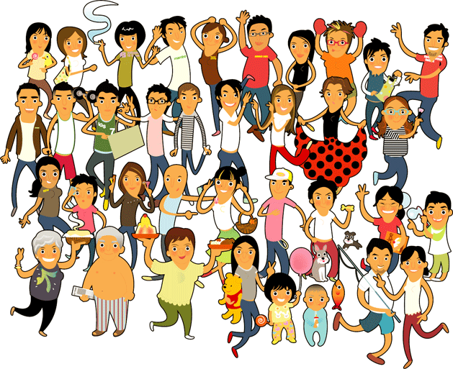
Only Roommates ?
Not only roommates , you go out on vacations with friends , you go out frequently with some friends and even at your home.
Throw away those untidy calculations , notes written on papers,bills maintained in a diary etc, sit back and relax , let our app do the calculations for you .

Slide 5
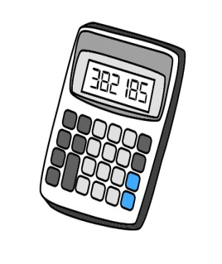
Big calculations made easy !
Ever encountered people carrying a big book , recording every expense . And what if the book is lost ? What if you forget how much someone owes you ?
Not anymore, we will provide dedicated servers to save every information , every expense you make and will let you know how much you are owed .

Slide 6

No group members !!
You don’t have anyone to share your expense with ???
No problem just signup and don’t create a group . Use our app only to keep a track of how much you are spending.
Instant calculator lets you divide your bills instantly.

Slide 7

Saving friendship !!!
People suffer from a big difficulty when asking for money .
Its not always easy to go and ask your friend for money . Specially when friendship is at risk .
Every transaction remain transparent to everyone so there are no chances of any fraud transaction being made.
Just remind your friend about how much he owes you by sending him a notification or sending him a text message.

Slide 8

How to start ?
Just download our app. Currently from link :http://j.mp/SplitFare
One time user registration .
Add a group . Give your group a name .
Add your group members.
Add transactions ans start settling bills.

Slide 9

Is it secured ?
Every user is concerned about security and privacy , and for that we have :
Full encryption on client
No clear text transmitted over network
Clear Text Never stored anywhere
Cache purged as soon as data committed
Salting Using Java Secure Random Class

Slide 10
Does It Consume lot of Data?
SplitFare Has Been Designed keeping the Indian user in mind .
India has very high data costs
SplitFare uses a maximum compute on client strategy.
The app fetches the minimum required amount of raw data from the ser ver and does most of the compute on the client itself.

Slide 11
Does it slow down my phone?
SplitFare runs almost no task in background when the app is not running.
The only service that runs in background is the GCMIntent receiver
We use Google Cloud Messaging(GCM) for notifications to client instead of a separate server polling mechanism. This not only saves a lot of data , but also saves battery and reduces CPU and memory usage.
All tasks run on separate threads and no processing is ever done on the UI thread. This ensures that the UI remains fast and responsive , no matter what be the case.

Slide 12
Can I Personalize it ?
We believe that everyone has his personal choices and hence we give the user the option to customize the visuals of the app as per his liking.
The user can set his currency , the app theme and the accent colors to his liking.
User preferences are stored on the server so that you do not need to set them again and again when you change your device.
Not from India? Change the currency to your local currency.

Slide 13
Cloud Based Model
SplitFare relies completely on the cloud
All data is safely and securely stored onto our servers so that you do not lose your data on changing your phone.
Combined with the reliability of the cloud and the speed of local compute , SplitFare tries to give the user the best possible experience.

Slide 14
Features of our app
As soon as you log into the app, a list of your groups is displayed with an option to create a new group. On this page itself, the other options available are
Refresh to Refresh the page.
Tutorial to show how to use the application.
My Profile to view and edit my profile (You can change your profile picture and your password)
Preferences to change the app accent color ,theme and the currency.
Log out to securely log out of your account

Slide 15
Features
When you select a group , the list of transactions is displayed along with the option to add a new transaction. Other options available are:
Summary to view the summary of all transactions. Here you have an option to clear the dues(If Any) or remind a group member to clear his/her dues.
Info to view group information , members and add new members . You can also change the group name and leave the group from here.
Repayments Made History to view a history of all repayments made
Repayments Accepted History to view a history of repayments accepted

Slide 16
Features
On long pressing any transaction you get several options.
If You did the transaction , you can view more details about the transaction , edit it or undo it.
If the transaction was made by someone else, you can only view more details.

Slide 17

Future development
We will be adding this app on play store with a full video tutorial on how to use this app .
We will add group chat so users can chat .
Logging in with social network like facebook , google+ , etc.
We will allow partial splitting within the group.

Slide 18
THANK YOU.

